Slide 1
If I only knew then what I know now…
Breakfast with the Chiefs
November 16, 2016
Chris Power
CEO, CPSI

Slide 2
Hospital Harm Measure
Where should our focus be?
  Improvement
  Patients and families
  Care providers

Slide 3
Things that have never happened before, happen everyday!

Slide 4
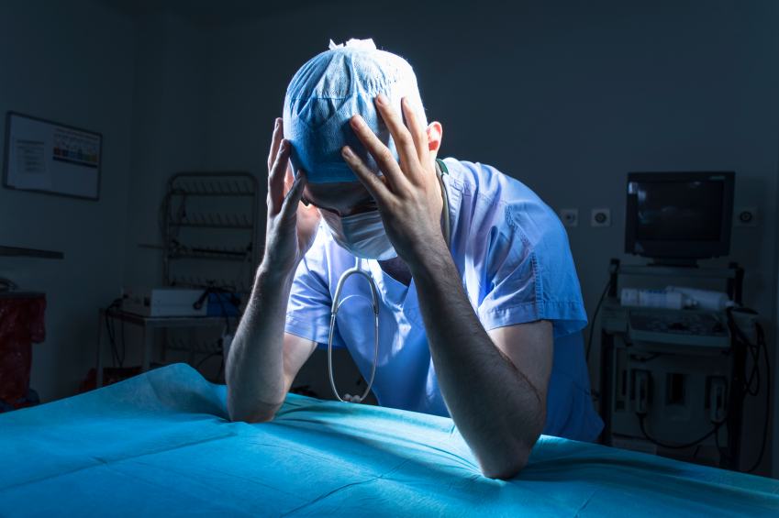
Second Victim/Wounded Healers
Have you ever been involved in unintentional harm?

Slide 5
“The instant patient harm occurs, the involved practitioner also becomes a patient of organizations – often a patient who is neglected.”
IOM

Slide 6

Provider Video
Notes:
Dr. Peter Pisters http://www.patientsafetyinstitute.ca/en/toolsResources/HealthcareProviderStories/Pages/Surgical-error-inspires-doctor-to-champion-the-safety-of-all-patients-2016-10.aspx
Dr. Amy Nakajima http://www.patientsafetyinstitute.ca/en/toolsResources/HealthcareProviderStories/Pages/Patients-unexpected-death-changes-the-way-one-obstetrician-thinks-all-doctors-should-be-educated-2016-10.aspx

Slide 7
What happens?
Immediately
Panicked
Horrified and apprehensive
Physical symptoms
Extreme sadness
Appetite disturbance
Difficulty concentrating

Slide 8
Then, what happens?
While Awaiting Investigation
Fear of:
Losing job
Being labelled incompetent / careless
Loss of respect
Involvement in lawsuit
Loss of license
Returning to work
The list goes on…

Slide 9
And finally?
Months that Follow
Characteristics of PTSD
Every day an eternity

Slide 10
Does this happen often?
Safety culture survey
1 in 7 staff reported
Anxiety, depression, concerns
2 out of 3 did not receive support

Slide 11
Consequences:
Dropping out
Surviving
Thriving

Slide 12

Regrets, I have a few…

Slide 13
5 Rights of Wounded Healers:
Treatment that is just
Respect
Understanding and compassion
Supportive care
Transparency and opportunity to contribute
Charles Denham

Slide 14
How would your organization rate?

Slide 15
Next steps?

Slide 16
Questions?

Slide 17
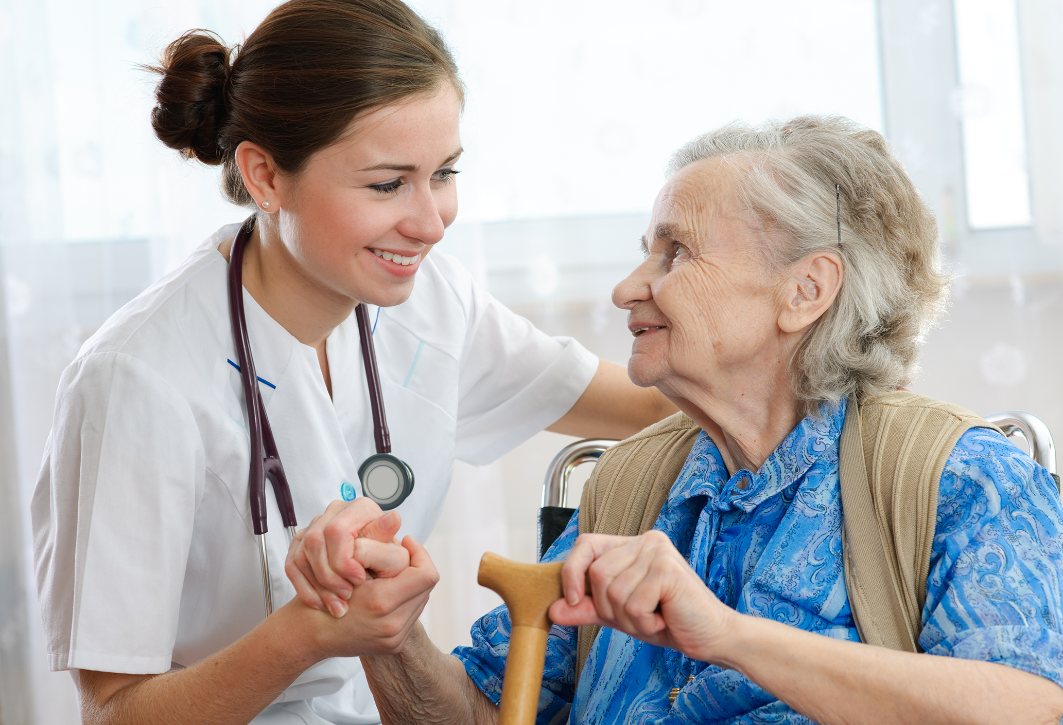
Thank You

